Slide 1
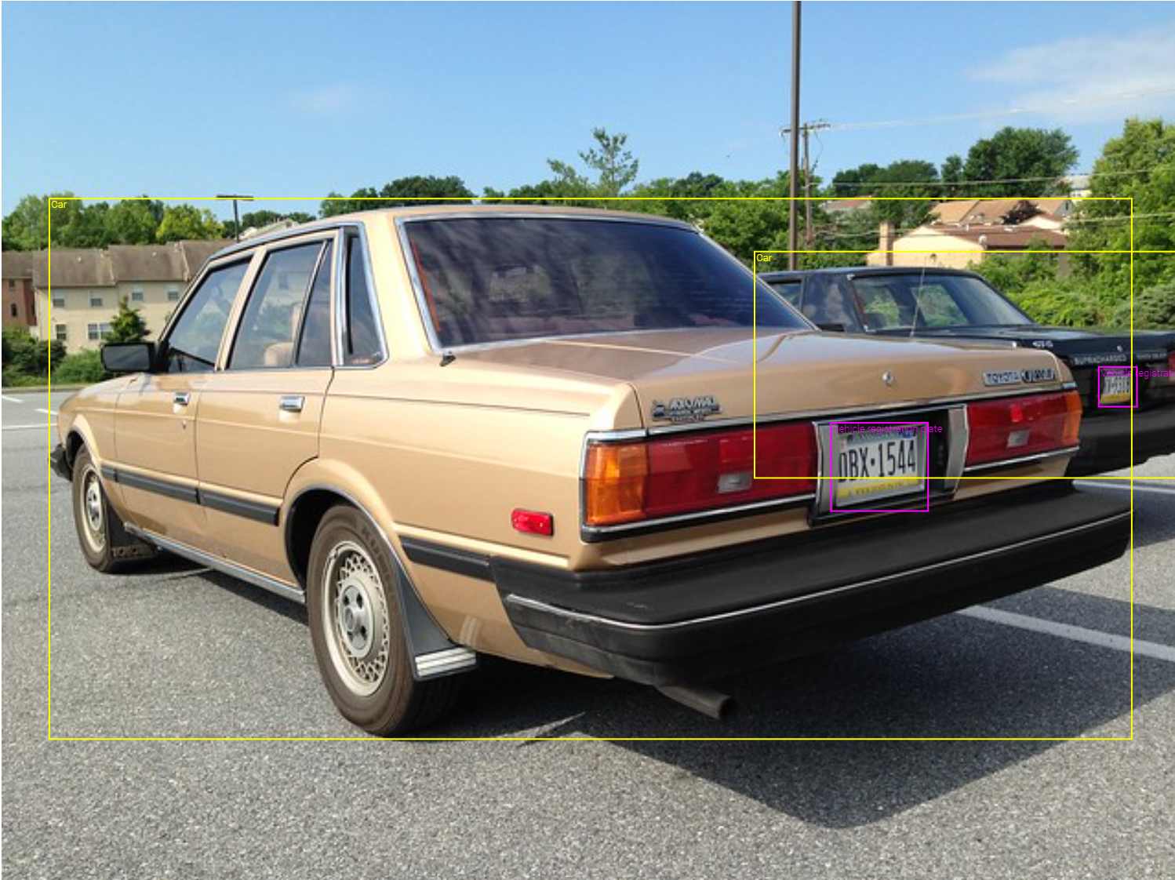

Automatic License Number Plate Detection
using
YOLO v4
Guidance
under
Prof. Dr. Chaojie (Jay) Wang
By:
Hemanth Akkenapally

Slide 2
Contents
Introduction
Objectives
Data Overview
Exploratory Data Analysis (EDA)
Model Application
Results
Conclusion
References

Slide 3
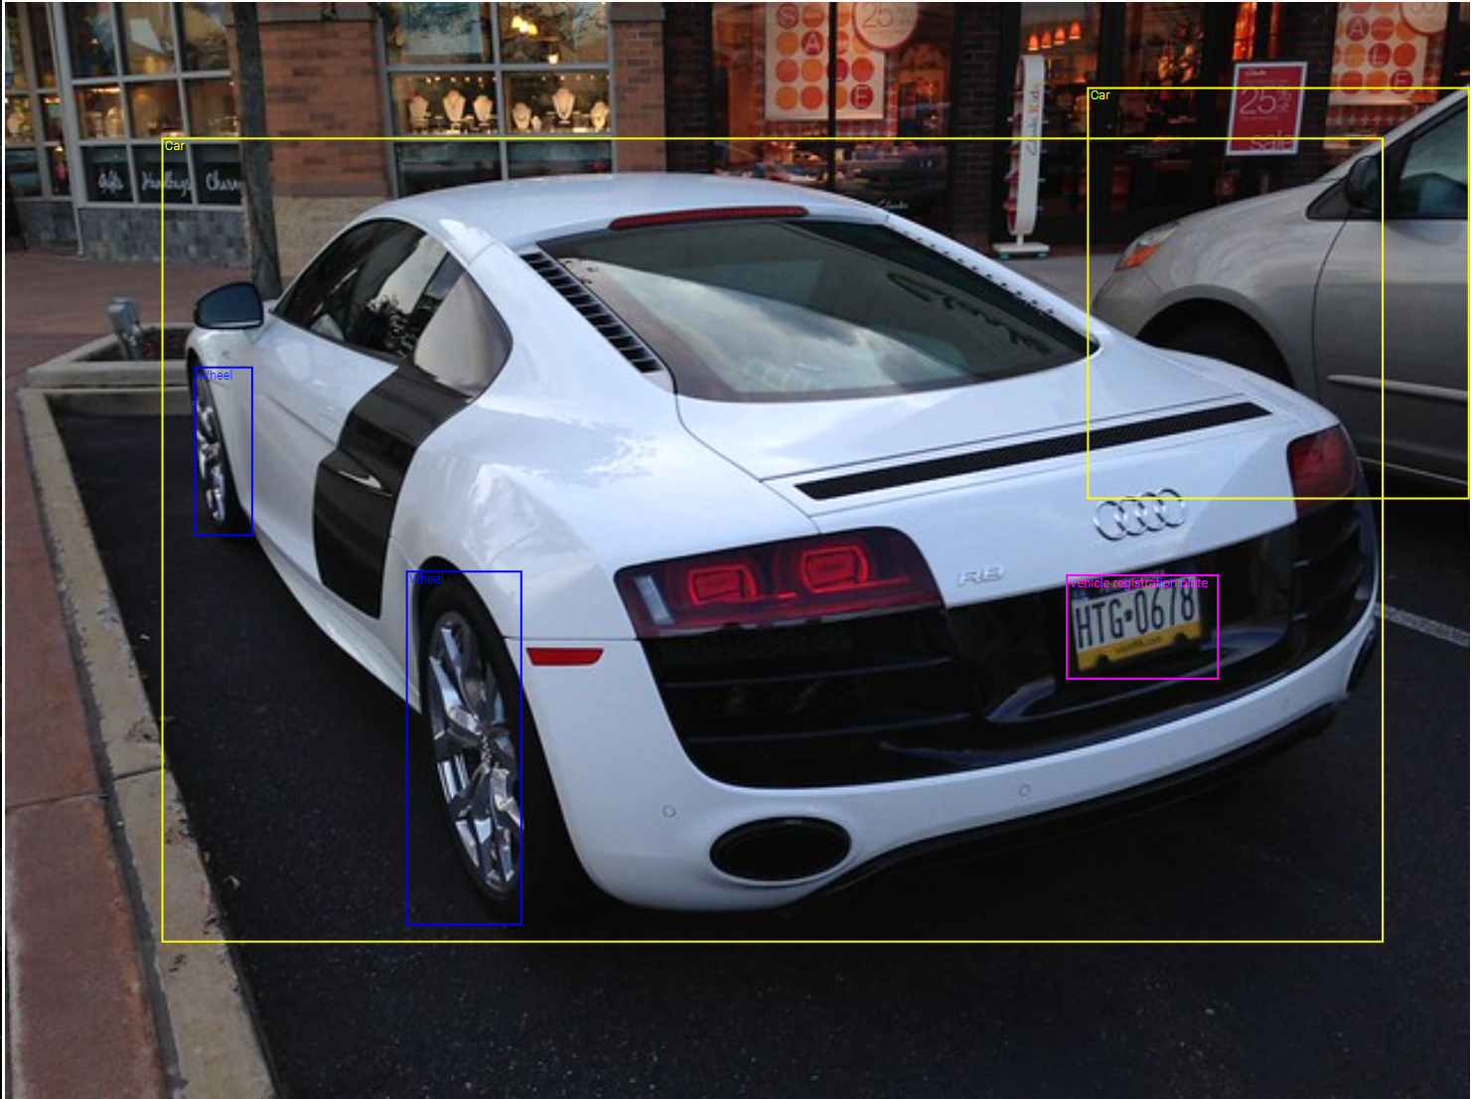
Introduction
Automatic License Number Plate recognition is a technology which uses optical character recognition to read vehicle plates.
ANPR systems typically use cameras and specialized software to capture images of vehicles and extract the alphanumeric characters from their license plates.

Slide 4
Objective
The aim is to develop a user-friendly interface that utilizes the YOLOv4 algorithm to automatically detect license plates from provided sample data.
This user interface will facilitate efficient plate detection, enabling seamless integration of the ANPR system into various applications such as traffic management, law enforcement, and vehicle tracking.
By leveraging the capabilities of the YOLOv4 algorithm and designing an intuitive UI, the project seeks to significantly improve the performance and usability of ANPR technology for diverse use cases.

Slide 5
Data Overview
Dataset is scrapped from open image dataset: "https://storage.googleapis.com/openimages/web/visualizer/index.html?type=detection&set=train&c=%2Fm%2F01jfm_"
Dataset contains Train, Validation and Test Images along with annotations.
Each image is scrapped with image file and a csv which contains the annotations of location of the plate.

Slide 6
contd..
Train dataset contains: 1500 images (total 1500 images + 1500 annotated entries in a csv file).
Validation dataset contains: 300 images (total 300 images + 300 annotated entries in a csv file)
Test dataset contains: 300 images (total 300 images + 300 annotated entries in a csv file)

Slide 7
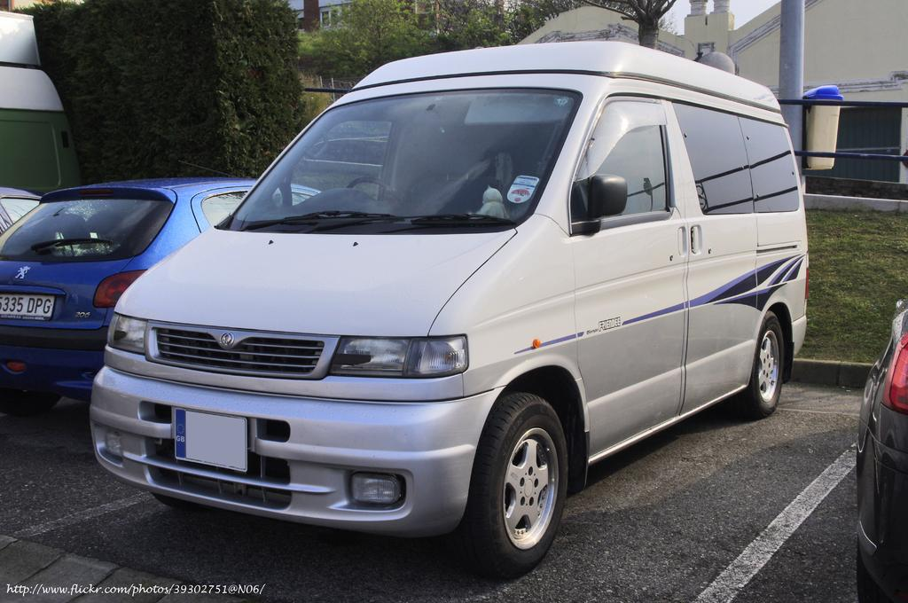
Data Preprocessing
Dataset is downloaded in the form of images and its respective labels
Ex: Annotation: Vehicle registration plate 622.72 405.75974400000007 798.08 494.079744
Each annotation represents the coordinates of the license plate inside the image.

Slide 8
contd..
YOLO algorithm is trained for our custom license plate using darknet which is an open source neural network framework.
To train the algorithm we need to get the data paths into certain txt.file where the locations are saved. Then we will configure the data file inside darknet folder, edit the configuration file which is used to train the neural network.
Coco.data, coco.names, yolov4-custom.cfg are files which are written to support the training of yolo on custom data.
Those files are uploaded inside github repo: https://github.com/Hemanth-Akkenapally/UMBC-DATA606-Capstone

Slide 9
Model Training:
YOLOv4 Algorithm weights are downloaded from official website and paste them inside darknet folder.
After fetching the convolution file “yolov4.conv.137” file, which is a pre trained weights which helps our model to train with stability and increases the chance of model to adapt faster to new type of dataset buy fine tuning the model.
Model will be trained using coco.data, yolov4-custom.cfg and yolov4.conv.137 files.
Training the model will depend on the cfg file inputs, they are described in next page.

Slide 10
Yolov4 configuration file:
Adjust the following parameters:
a. max_batches: Set to 6000, or (# of classes) * 2000 if greater than 6000.(How many batches will training process through, each batch as some set of images, it prevents underfitting, overfitting.)
b. steps: Calculate as 80% and 90% of max_batches.(adjusted for learning rate of model)
c. filters: Compute as (# of classes + 5) * 3.(Number of convolutional filters in yolo network. )

Slide 11
contd..
Configure dimensions:
width and height: Choose any multiple of 32, with 416 as standard (can use larger values like 608 for potentially improved results, albeit slower training).
Optionally, to address memory concerns or speed up training:
Modify one line in each of the three YOLO layers from random = 1 to random = 0. This change may reduce model accuracy slightly but can accelerate training and save memory.

Slide 12
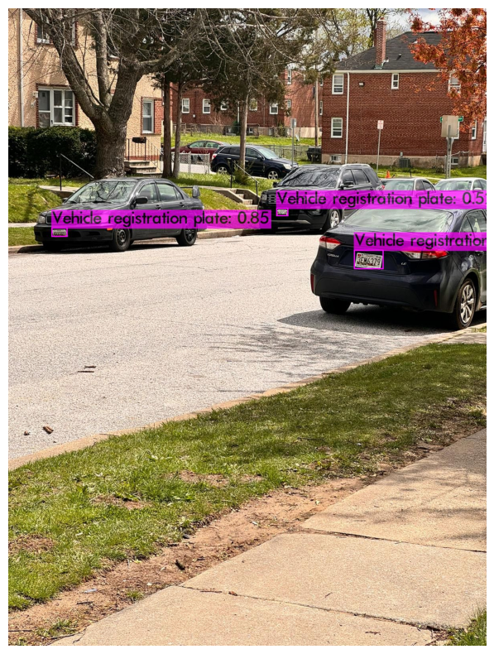
Results:
After training the model, it will generate best weights which we can use to test the images.
Accuracy of the detection depends on the picture
We can use the custom weights as many times as we can.

Slide 13
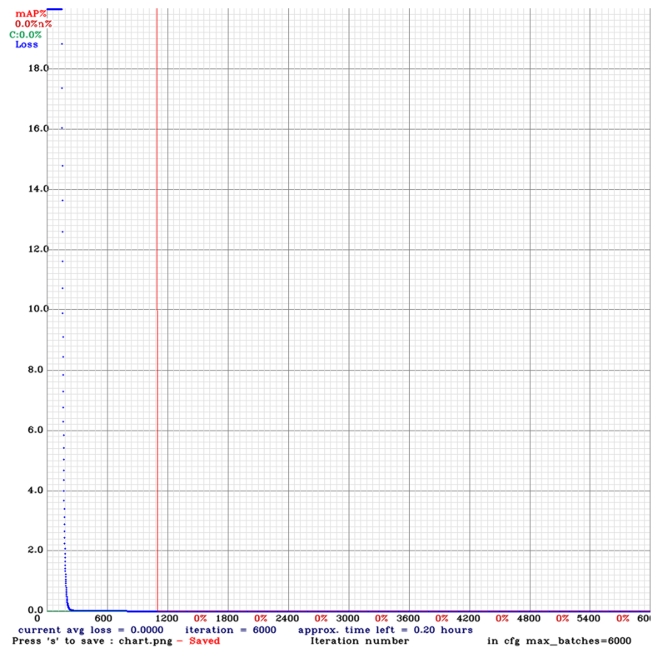
We can test it on videos too, but the frame rate might decrease in the output.
Trained model generates a graph which shows the error rate vs number iterations CNN is trained.

Slide 14
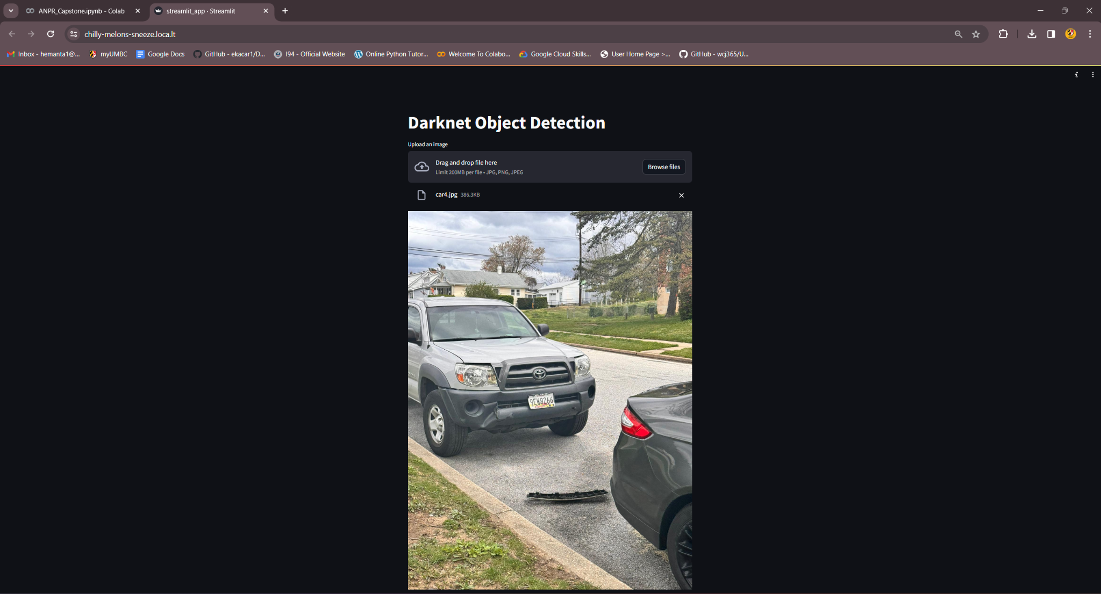
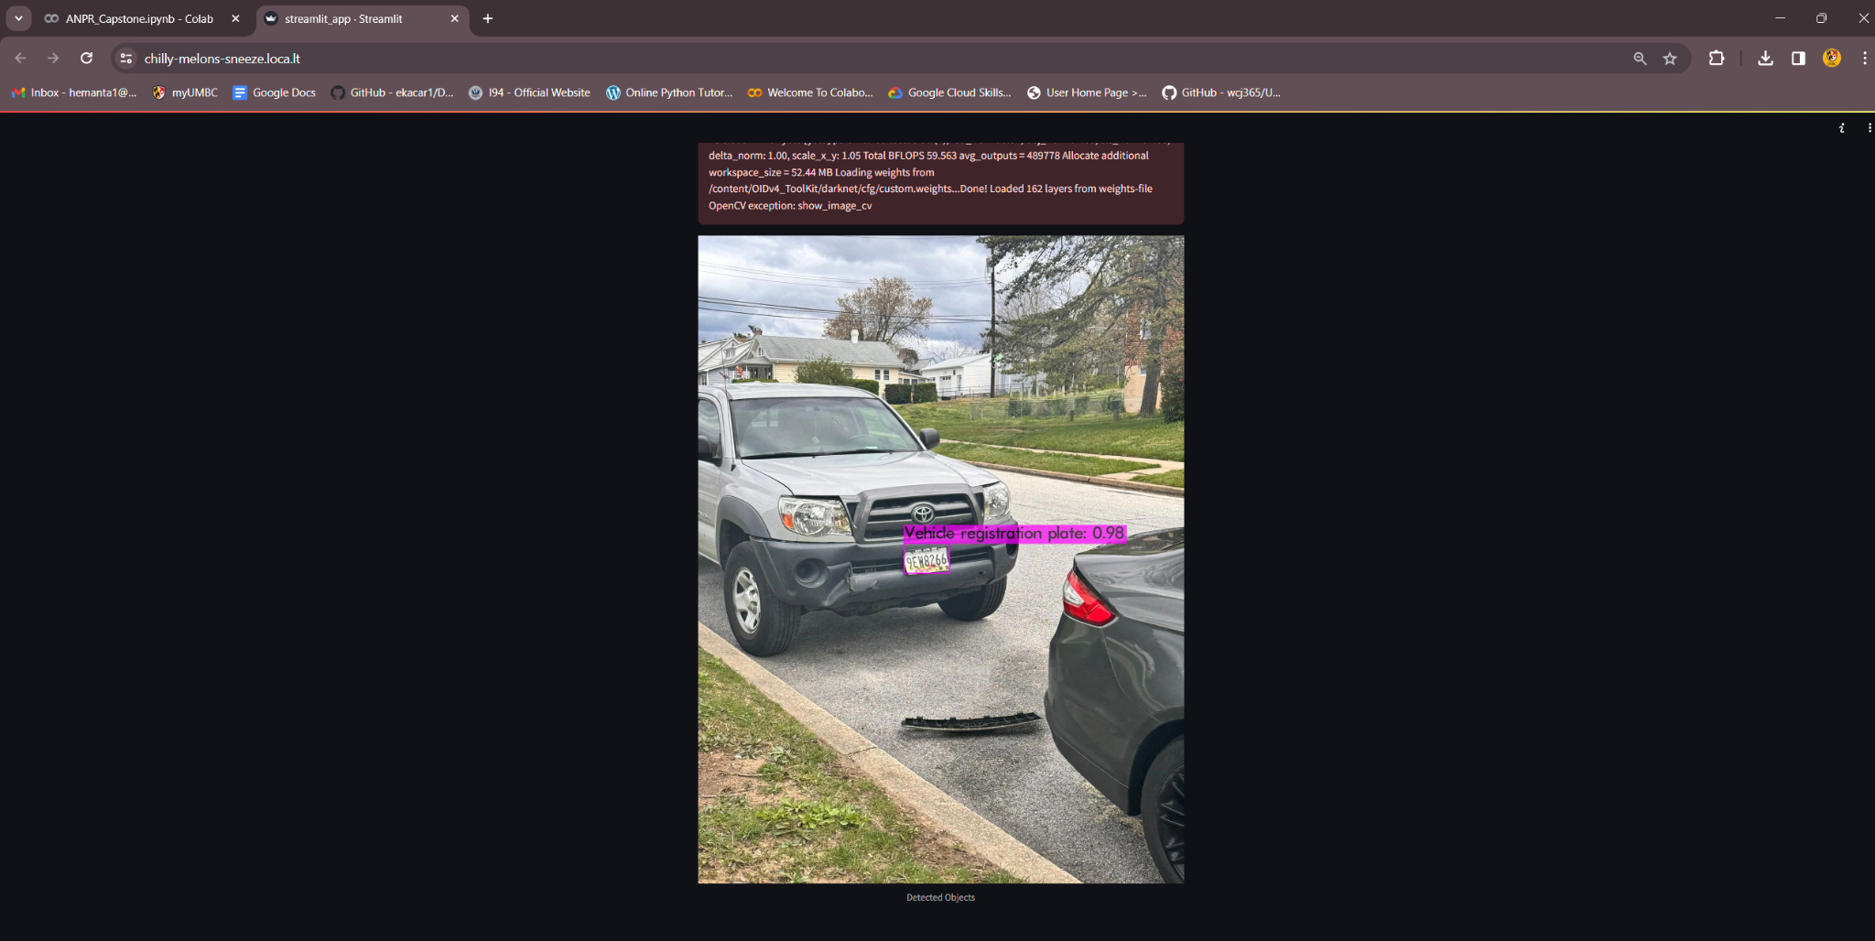
Web Page using Streamlit:

Slide 15
References
https://arxiv.org/abs/2004.10934
https://developer.nvidia.com/cuda-toolkit
https://pjreddie.com/darknet/yolo/

